Slide 1
Lecture 4
Python Basics

Slide 2
Learning Objectives Today
Python Advantages
Python Basic Syntax
Python Expressions
Python Statement
Python Comments
Python Data Types
Python Casting

Slide 3
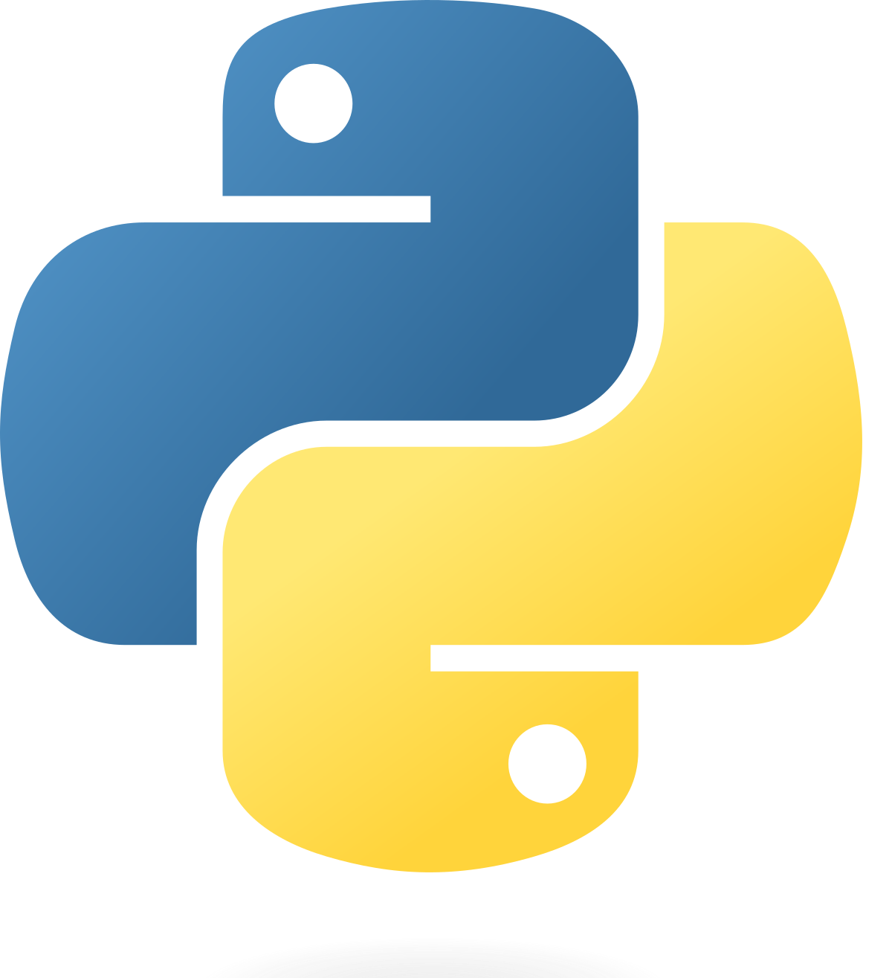
Python
Python supports multiple programming paradigms, including Procedural, Object Oriented and Functional programming language. Python design philosophy emphasizes code readability with the use of significant indentation.

Slide 4
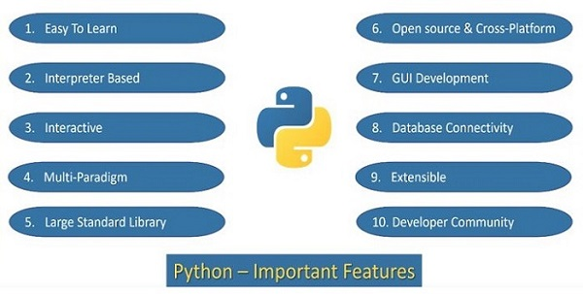
Python Important Features

Slide 5
Python Advantages
Python 3 has a simple syntax that is easy to learn and read, making it a good choice for beginners.
Python 3 is a high-level language that has a large standard library and many third-party libraries available, making it a versatile language that can be used for a wide variety of applications.
Python 3 supports multiple programming paradigms, including object-oriented, functional, and procedural programming.
Python 3 is an interpreted language, meaning that it does not need to be compiled before running, making it easy to write and test code quickly.
Python 3 has good support for data analysis and scientific computing, with libraries such as NumPy and Pandas.

Slide 6
Python Disadvantages
Python 3 can be slower than compiled languages such as C++ or Java, which may be a concern for applications that require high performance.
Python 3 has a global interpreter lock (GIL), which can limit its ability to take advantage of multiple CPU cores.
Python 3 may not be the best choice for low-level systems programming, as it does not offer the same level of control over hardware as other languages.
Python 3 is not as popular in some fields as other languages, such as R for data analysis or C++ for game development, so it may not always be the best choice for specific applications.

Slide 7
Python vs (C, C++)
Syntax
Type System
Abstraction
Performance
Portability
Usage
Learning Curve
Compiled vs Interpreted
Cross Platform
OOP Concepts
Application Areas
https://www.tutorialspoint.com/python/python_vs_cpp.htm

Slide 8

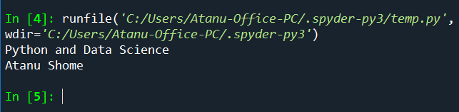
Python Expressions
Python expressions are pieces of code that produce a value when evaluated. They can be simple or complex, involving literals, variables, operators, function calls, and more.

Slide 9
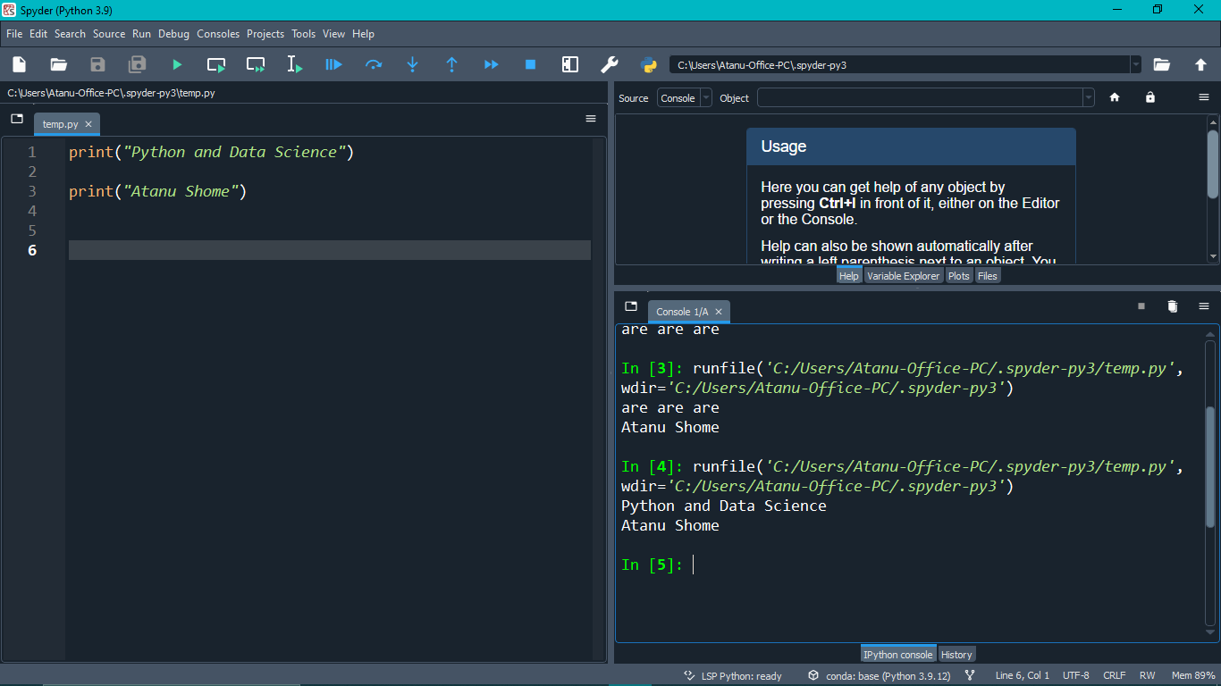
Compiler
How about online?
IDE vs Notebook

Slide 10
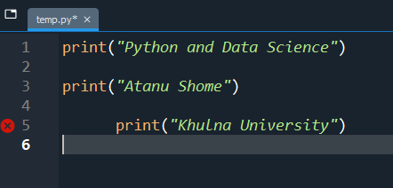

Python Indentation

Slide 11
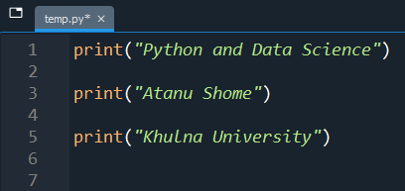
Python Indentation

Slide 12
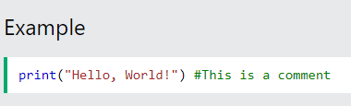
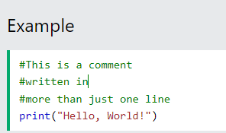
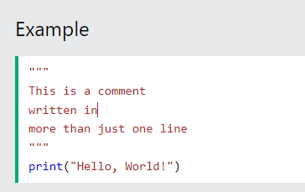
Python Comments

Slide 13
Variable
x = 2
s = "atanu"
f = 2.55
print(x)
print(s)
print(f)

Slide 14
Python Expressions
Arithmetic Expressions:
result = 2 + 3 * 4 # Addition and multiplication
print(result)
Variable Assignments:
x = 10 # Assignment of a value to a variable
Function Calls
import math
y = math.sqrt(25) # Calling a function (sqrt) from the math module
print(y)

Slide 15

Python Expressions
Boolean Expressions
a = 5
b = 10
is_greater = a > b # Comparison operator producing a boolean value
String Concatenation:
greeting = "Hello, " + "world!" # Concatenating two strings

Slide 16
Python Statements
Python statements are instructions that the Python interpreter can execute. Unlike expressions, which produce a value, statements perform actions such as defining variables, control flow, and interacting with the environment.

Slide 17
Python Statement
Conditional Statements (if-elif-else):
if x > 0:
print("Positive")
elif x == 0:
print("Zero")
else:
print("Negative")

Slide 18
Python Statement
Loop Statements (for and while loops):
for i in range(5):
print(i)

Slide 19
Python Statement
Functional Statements
def greet(name):
print("Hello, " + name + "!")
greet("Alice")
Break, continue, import, return, del
Indentation is big thing

Slide 20
Back to Print
x = "Python "
y = "is "
z = "awesome"
print(x + y + z)
x = "Python"
y = "is"
z = "awesome"
print(x, y, z)
https://www.geeksforgeeks.org/python-output-formatting/

Slide 21
Back to Print
print("This is class number: %d" %1)
print("Geeks : %2d, Portal : %5.2f" % (1, 45000.333))
print("Total students : %3d, Boys : %2d" % (240, 120)) # print integer value
print("%7.3o" % (25)) # print octal value
print("%10.3E" % (356.08977)) # print exponential value
T = 55.25
print ("I have "+ str(T) + " take")

Slide 22
Back to print
print('I love {} for "{}!"'.format('Geeks', 'Geeks'))
# using format() method and referring a position of the object
print('{0} and {1}'.format('Geeks', 'Portal'))
print('{1} and {0}'.format('Geeks', 'Portal'))

Slide 23
Back to Print
# combining positional and keyword arguments
print('Number one portal is {0}, {1}, and {other}.'
.format('Geeks', 55.55, other ='Geeks'))
# using format() method with number
print("Geeks :{0:2d}, Portal :{1:8.2f}".
format(12, 00.546))
# Changing positional argument
print("Second argument: {1:3d}, first one: {0:7.2f}".
format(47.42, 11))
print("Geeks: {a:5d}, Portal: {p:8.2f}".
format(a = 453, p = 59.058))

Slide 24
Assign multiple values
x, y, z = "Orange", "Banana", "Cherry"
print(x)
print(y)
print(z)
Mixing types????

Slide 25
Assign Multiple Values
fruits = ["apple", "banana", "cherry"]
x, y, z = fruits
print(x)
print(y)
print(z)

Slide 26
User Input
username = input("Enter username:")
print("Username is: " + username)

Slide 27
Scope of Variables
x = "awesome"
def myfunc():
x = "fantastic"
print("Python is " + x)
myfunc()
print("Python is " + x)

Slide 28
Scope of Variables (Global)
def myfunc():
global x
x = "fantastic"
myfunc()
print("Python is " + x)

Slide 29
Scope of Variables
x = "awesome"
def myfunc():
global x
x = "fantastic"
myfunc()
print("Python is " + x)

Slide 30
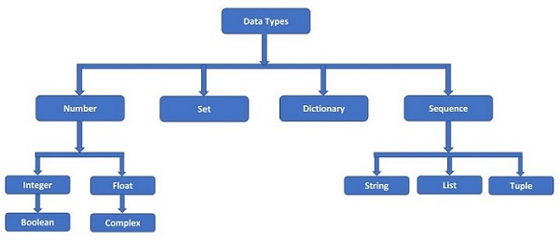
Data Types

Slide 31
Try Out
Input a number and print
Input a number 1451.1545 into the variable and output only two decimal values
Take two strings and an integer. Print a single string.

Slide 32
Casting
x = float(1) # x will be 1.0
y = float(2.8) # y will be 2.8
z = float("3") # z will be 3.0
w = float("4.2") # w will be 4.2
print(x)
print(y)
print(z)
print(w)
x = str("s1") # x will be 's1'
y = str(2) # y will be '2'
z = str(3.0) # z will be '3.0'
print(x)
print(y)
print(z)
x = int(1)
y = int(2.8)
z = int("3")
print(x)
print(y)
print(z)

